Slide 1
Web Engineering
Lab 4
Introduction of CSS With properties

Slide 2
What is CSS?
CSS stands for Cascading Style Sheets
CSS is a language that describes the style of an HTML document.
It can control the layout of multiple web pages all at once
External style definitions are normally saved in external .css files.

Slide 3
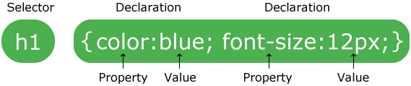
CSS Syntax
A CSS rule-set consists of a selector and a declaration block:
CSS selectors are used to select HTML elements based on their element name, id and class.

Slide 4
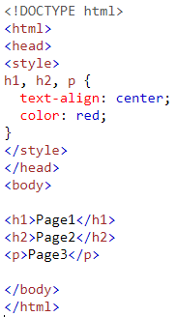
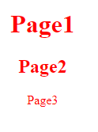
Grouping Selectors
To group selectors, separate each selector with a comma.

Slide 5
How To Insert CSS
Three Ways to Insert CSS
External style sheet
Internal style sheet
Inline style

Slide 6
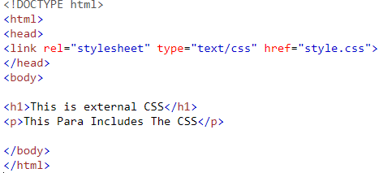
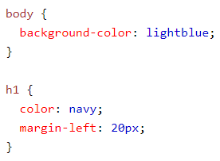
External Style Sheet
Each page must include a reference to the external style sheet file inside the <link> element. The <link> element goes inside the <head> section:
 | Style.css

Slide 7
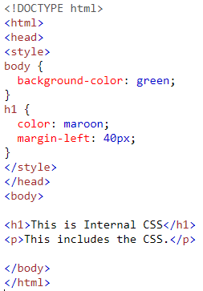
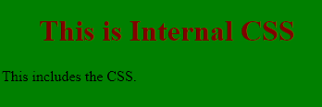
Internal Style Sheet
Internal styles are defined within the <style> element, inside the <head> section of an HTML page:

Slide 8
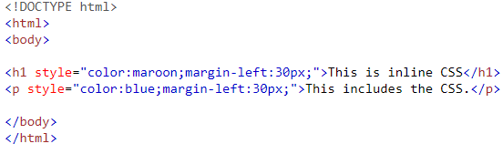

Inline Styles
An inline style may be used to apply a unique style for a single element.

Slide 9
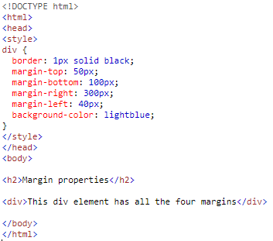
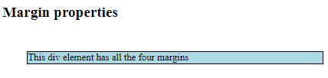
1-CSS Margins
The CSS margin properties are used to create space around elements, outside of any defined borders.
There are four properties for setting the margin for each side of an element (top, right, bottom, and left) having values as auto,length,%,inherit.

Slide 10
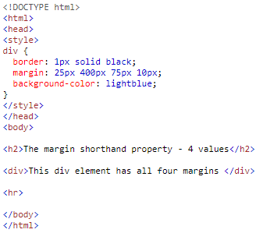

Use the margin shorthand property with four values:

Slide 11
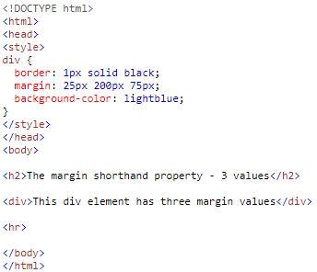

If the margin property has three values:

Slide 12
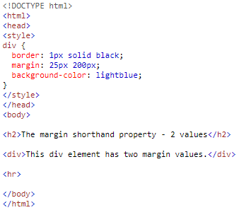

If the margin property has two values:

Slide 13
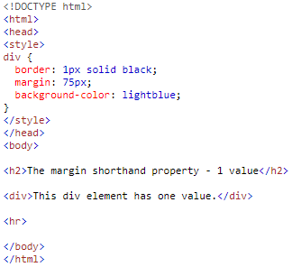
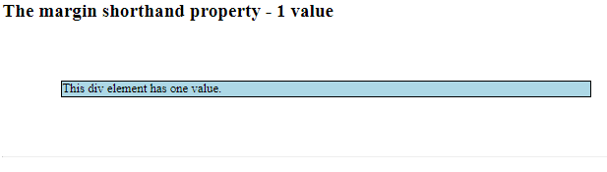
If the margin property has one values:

Slide 14
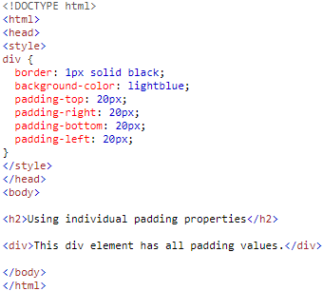

2-CSS Padding
The CSS padding properties are used to create space around elements, inside of any defined borders.
There are four properties for setting the padding for each side of an element (top, right, bottom, and left) having values as length,%, inherit.

Slide 15
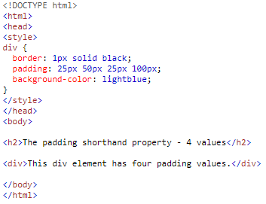
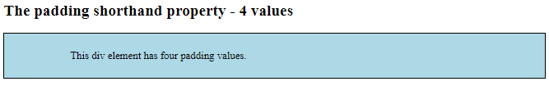
Use the padding shorthand property with four values:

Slide 16
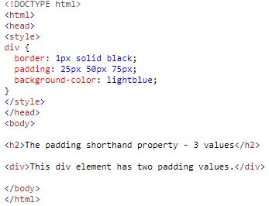
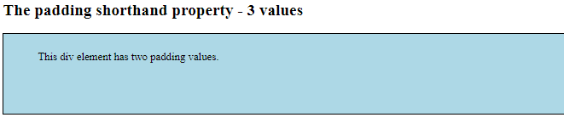
If the padding property has three values:

Slide 17
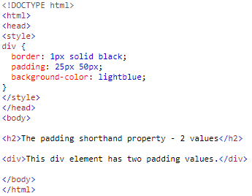
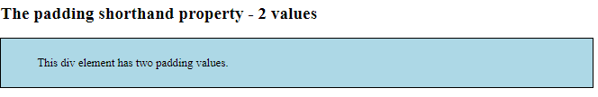
If the padding property has two values:

Slide 18
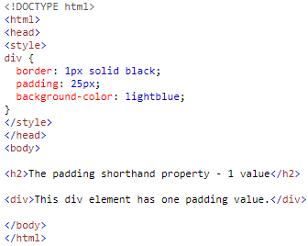
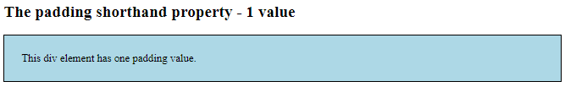
If the padding property has one values:

Slide 19
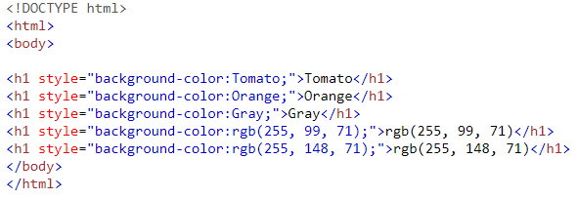
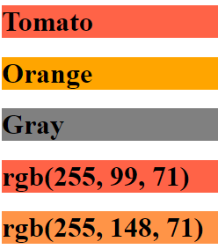
3- Background Color

Slide 20
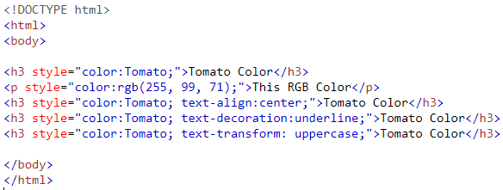
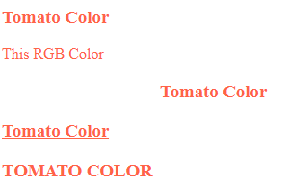
4- Text Color

Slide 21
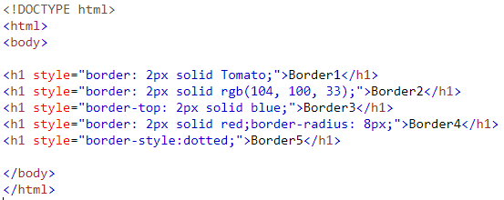
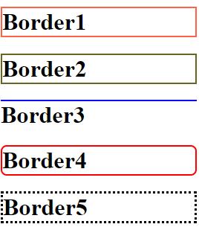
5-Border Color

Slide 22
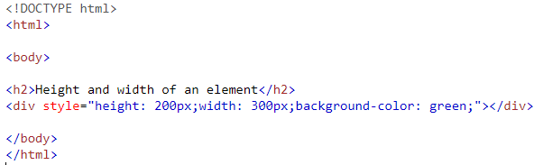
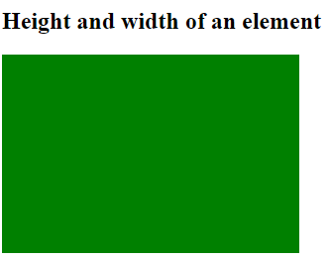
6-Height and Width

Slide 23
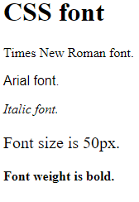
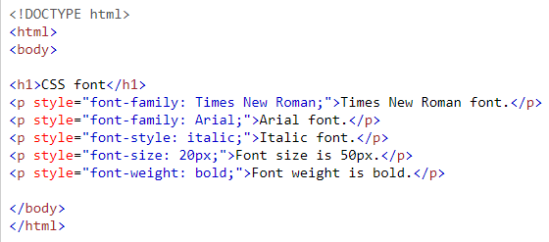
7- Fonts

Slide 24
Questions

